Slide 1

 | S.S.V.P.S’s B. S. Deore Polytechnic, Dhule Academic Year : 2022 – 2023 Department of Computer Engineering (0059)
A seminar on Capstone Project Execution (CPE-22060)
Topic |  | Face Recognition using Haar Cascade and LBPH Algorithm
Presented by |  | 1. Aayush Shashikant Jadhav
 |  | 2. Pranav Sudhakar Babrekar
 |  | 3. Nayan Bhaskar Bhadane
 |  | 4. Khushal Hirchand Patil
Guided by |  | Mr. C.P.Bhamare
Semester |  | Sixth (I Scheme) | Date : 9/5/2023

Slide 2
Content
Abstract
Introduction (background of the industry or used based problem / task)
Literature Survey
Scope of the project
Methodology
Details of designs, working and processes
Results and applications
Conclusion and future scope
References and Bibliography

Slide 3
1. Abstract
The attendance system is used to track and monitor whether a student attends a class. There are different types of attendance systems like Biometric-based, RFID based, face recognition based and old Register-based attendance system. Out of them all, a Face recognition based attendance system is more secure and time-saving.
The proposed system will be implemented using algorithm
1. Haar cascade for face detection and
2. Local Binary Pattern Histogram(LBPH) algorithm for face recognition.

Slide 4
2. Introduction
Taking attendance every day helps determine the average percentage of student’s presence throughout the year and the dropouts rate.
In traditional attendance system is a manual entry for the Faculty. Here the attendance will be carried out in the hand written registers. Maintaining the records for the Faculty is a tedious job.
The objective of our proposed system is to create a face recognition based attendance system using Haar cascade for face detection and LBPH algorithm for face recognition and mark the attendance in database.

Slide 5
3. Literature Survey
YEAR | AUTHOR | OBJECTIVES | METHODOLOGY | PROBLEMS
2012 | Ononiwu G. Chiagozie & Okorafor G. Nwaji | Radio-frequency identification (RFID)based Attendance System with Automatic Door Unit | In this study of [2] Radio-frequency identification (RFID) is a technology that uses radio waves to transfer data from an electronic tag, called RFID tag or label uses energy from the tag reader and then attendance is marked. | In this approach the problem is that An unknown person can make use of a valid ID card and enter the University.

Slide 6
3. Literature Survey
YEAR | AUTHOR | OBJECTIVES | METHODOLOGY | PROBLEMS
2012 | O.Shoewu, PhD, & O.A. Idowu, B.Sc. | Development of Attendance Management System using Biometrics. | In this study of [3] attendance management system it uses fingerprint identification. In identification, the system recognizes an individual by comparing his/her biometrics with every record in the database. | The problem with this method is that for attendance students should go to the place where this hardware device is located or pass the hardware device around the students during class which can be a distraction to the students.

Slide 7
3. Literature Survey
YEAR | AUTHOR | OBJECTIVES | METHODOLOGY | PROBLEMS
2013 | Jomon Joseph1 & K. P. Zacharia | Automatic Attendance Management System Using Face Recognition | In this study of [4] authors proposed a face recognition based attendance system based on Eigenface recognition. Images are converted into eigenfaces, Recognition is performed by comparing eigenface got from the input image and eigenfaces in the database. | The problem with this approach is that this method is very sensitive to face background, head orientations and it doesn’t recognize the face of a person if the person is wearing glasses or a grown beard, etc.

Slide 8
Problem Definition
This proposed automated Attendance system is based on haar cascade for face detection and the LBPH algorithm for face recognition and attendance of the respective student will be marked automatically on table present in database.

Slide 9
4. Scope of the project
4.1 User Requirements
Taking and tracking student attendance by facial recognition in specific time.
It should not be sensitive to face background, head orientations and it should recognizes a person’s face even if he grows a beard or wears glasses, etc.
Compute the total attendance based on detected faces.
The faculty can export attendance report in PDF format.

Slide 10
4.2 System Requirements
Software Requirements Platform :
Operating System : Windows OS
Platform: Visual Studio Code
Programming Language : PYTHON
Libraries: OpenCV, Tkinter, NumPy, ReportLab, Pygame, Pillow
2. Hardware Requirements
Processor: INTEL i3 Processor Core
Hard Disk: 500 GB (min)
RAM: 2 GB or higher
Camera : Webcam

Slide 11
5. Methodology
5.1 System Diagram
Add Students Information in Database
Mark Attendance using Euclidean Distance Formula for Face Recognition
Save Attendance with Class Details, Date and Time in Database Table
Create Dataset using Haar Cascade algorithm
Take Photos of respective student
Train Dataset using LBPH algorithm
XML file is generated after Training Data
Take Attendance on basis of Class Details
View Attendance on basis of Class Details and Date
Export Attendance Report in PDF format
END
START

Slide 12
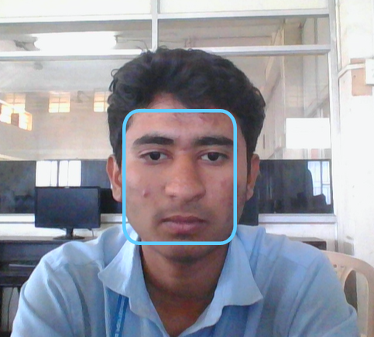
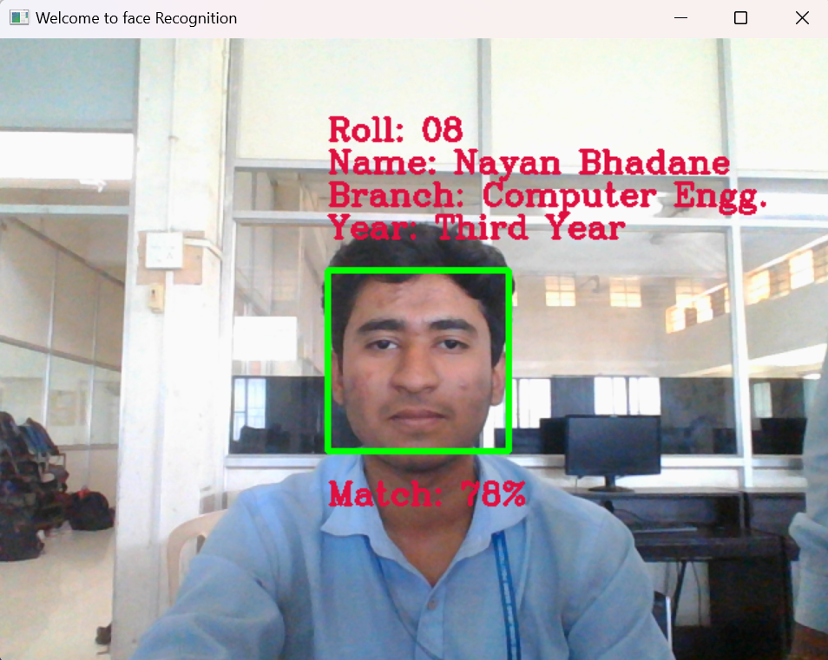
5.2 Algorithms
5.2.1 Detection and Recognition
Face Detection
(Haar Cascade)
Face Recognition
(LBPH)

Slide 13
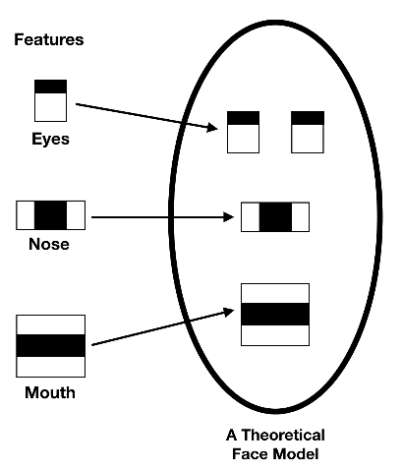
5.2.2 Haar Cascade Algorithm
It is an Object Detection Algorithm used to identify faces in an image or a real time
The algorithm is given a lot of positive images consisting of faces, and a lot of negative images not consisting of any face to train on them
OpenCV has haarcascade_frontalface_default.xml file that already contains various pre-trained classifiers for face, eyes, smile, etc. This XML file is stored in opencv/data/haarcascades/ folder .

Slide 14
5.2.2 Haar Cascade Algorithm

Slide 15
5.2.3 LBPH Algorithm
It was first defined in 1994 (LBP) and since that time it has been found to be a powerful algorithm for texture classification.
Local Binary Pattern Histogram algorithm is a simple approach that labels the pixels of the image thresholding the neighborhood of each pixel.
In other words, LBPH summarizes the local structure in an image by comparing each pixel with its neighbors and the result is converted into a binary number.

Slide 16
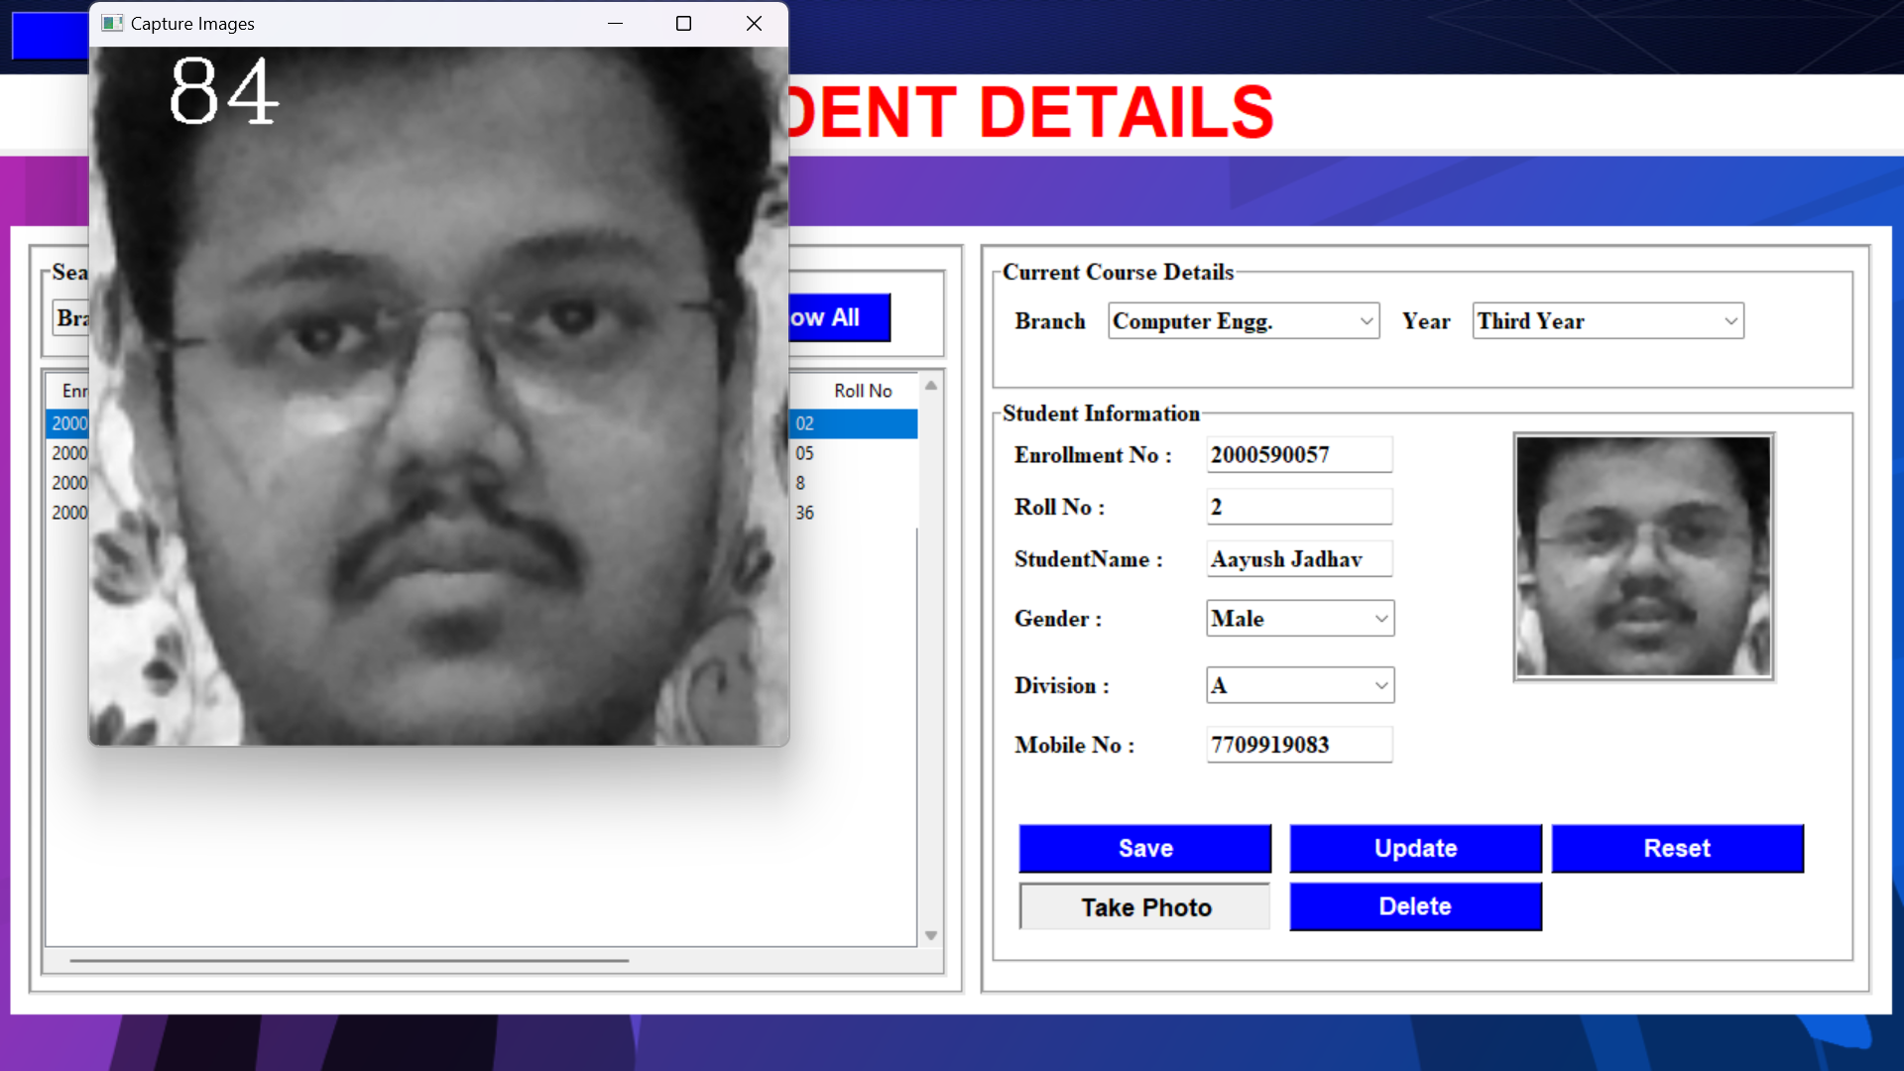
Adding Student Details and Capture Images
Step 1: Create Dataset
First, we need to train the algorithm. To do so, we need to use a dataset with the facial images of the people we want to recognize. We need to also set an ID for each image, so the algorithm will use this information to recognize an input image and give you an output. Images of the same person must have the same ID. We have used Enrollment number as ID.

Slide 17
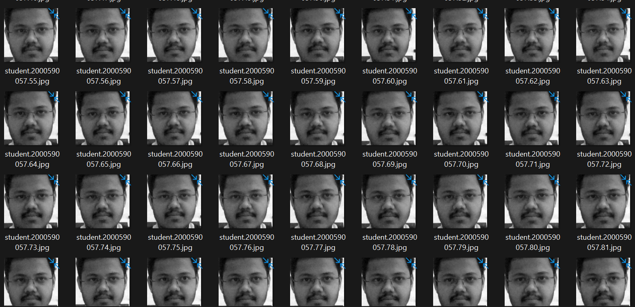
Adding Student Details and Capture Images
Step 1: Create Dataset
First, we need to train the algorithm. To do so, we need to use a dataset with the facial images of the people we want to recognize. We need to also set an ID for each image, so the algorithm will use this information to recognize an input image and give you an output. Images of the same person must have the same ID. We have used Enrollment number as ID.

Slide 18
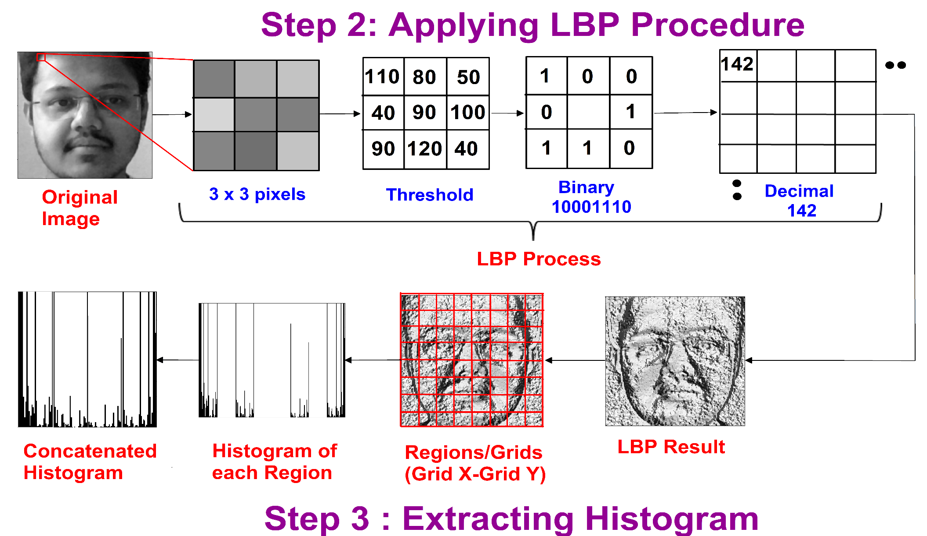
Train Data
The first computational step of the LBPH is to create an intermediate image that describes the original image in a better way, by highlighting the facial characteristics. The algorithm uses a concept of a sliding window, based on the parameters radius and neighbors.
Now, using the image generated in the last step, we can use the Grid X and Grid Y parameters to divide the image into multiple grids, as can be seen in the following image

Slide 19
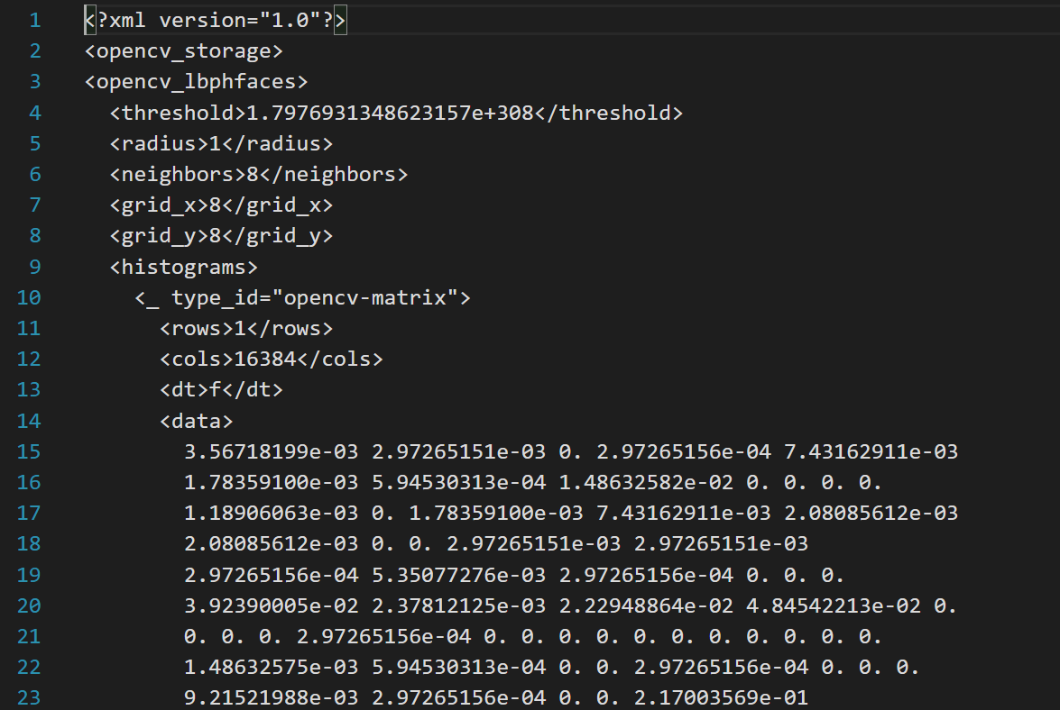
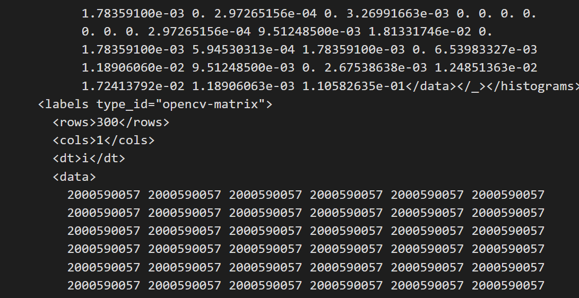
After Training Data is completed an XML file will be generated as output as shown below

Slide 20
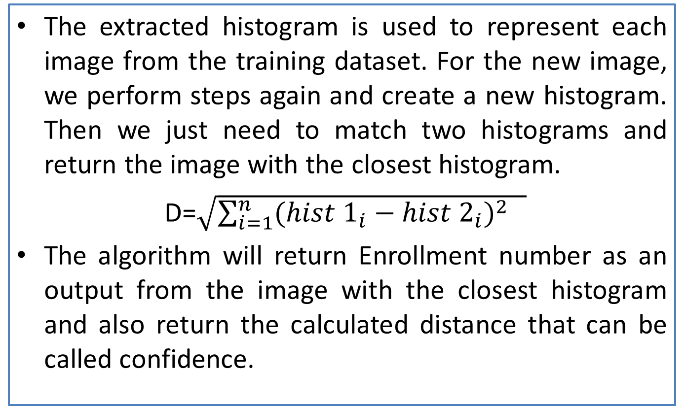
Take Attendance
Step 4: Performing Face Recognition
The extracted histogram is used to represent each image from the training dataset. For the new image, we perform steps again and create a new histogram. Then we just need to match two histograms and return the image with the closest histogram.
D=$\sqrt{\sum_{i=1}^{n}{(hist 1_{i}−hist 2_{i})^{2} } }$
The algorithm will return Enrollment number as an output from the image with the closest histogram and also return the calculated distance that can be called confidence.

Slide 21
Take Attendance
Step 5: Marking Attendance
If the confidence is lower than the threshold value, that means the algorithm has successfully recognized the face.
Then the Student attendance will be marked on basis of the Enrollment number returned.

Slide 22
6.Details of designs, working and processes
6.1 Modules
Login
Modules for Admin
Manage Users
Student Details
Modules for Faculty
Take Attendance
View Attendance

Slide 23
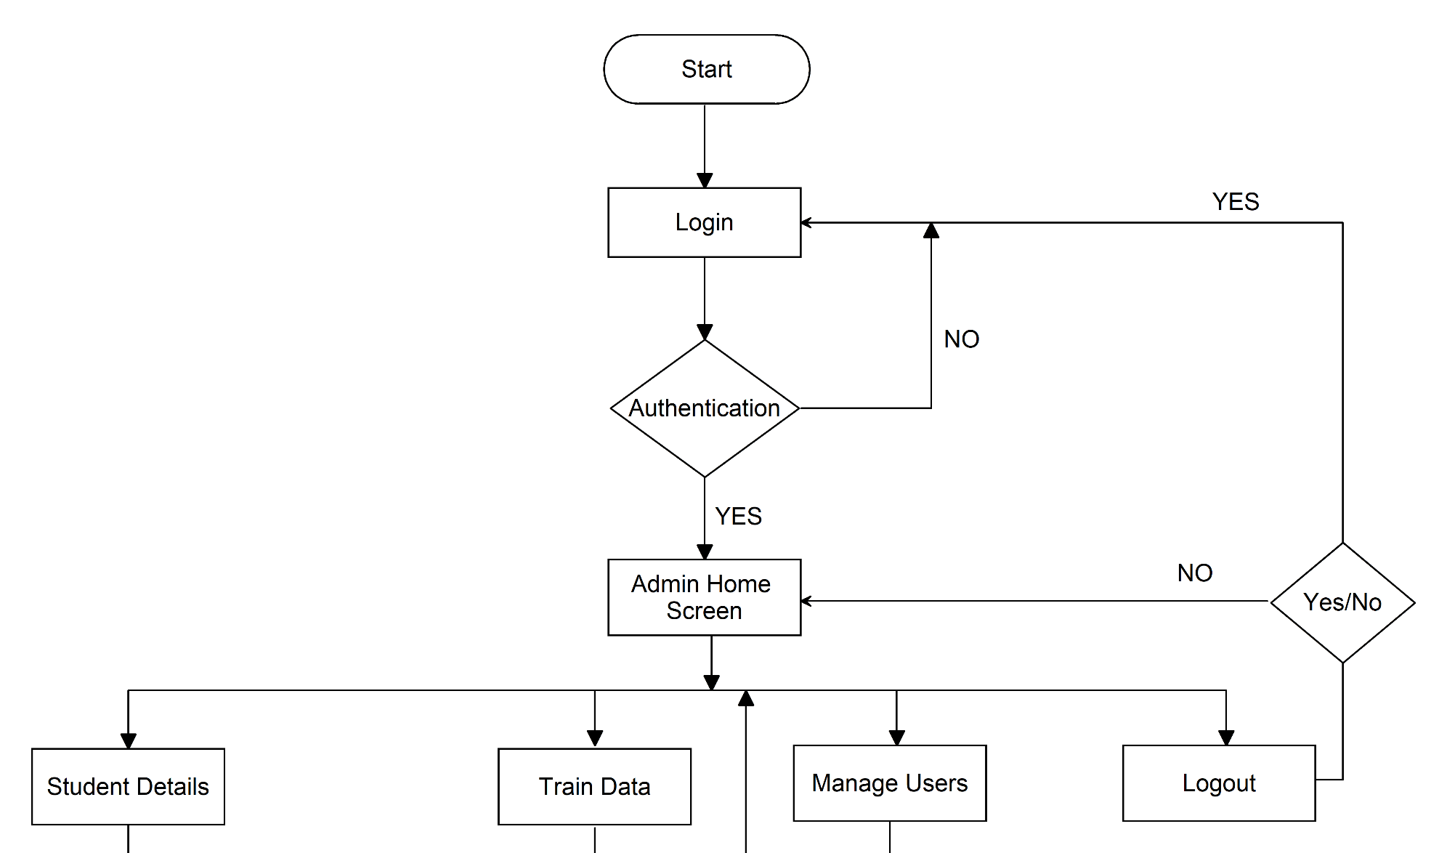
6.2 Admin Module Design

Slide 24

6.2 Admin Module Design

Slide 25
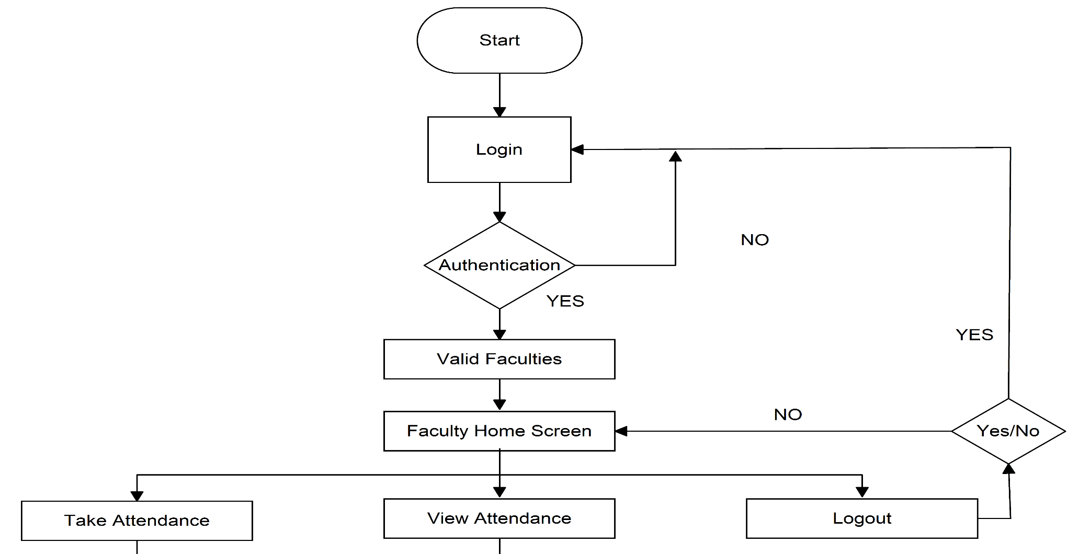
6.3 Faculty Module Design

Slide 26
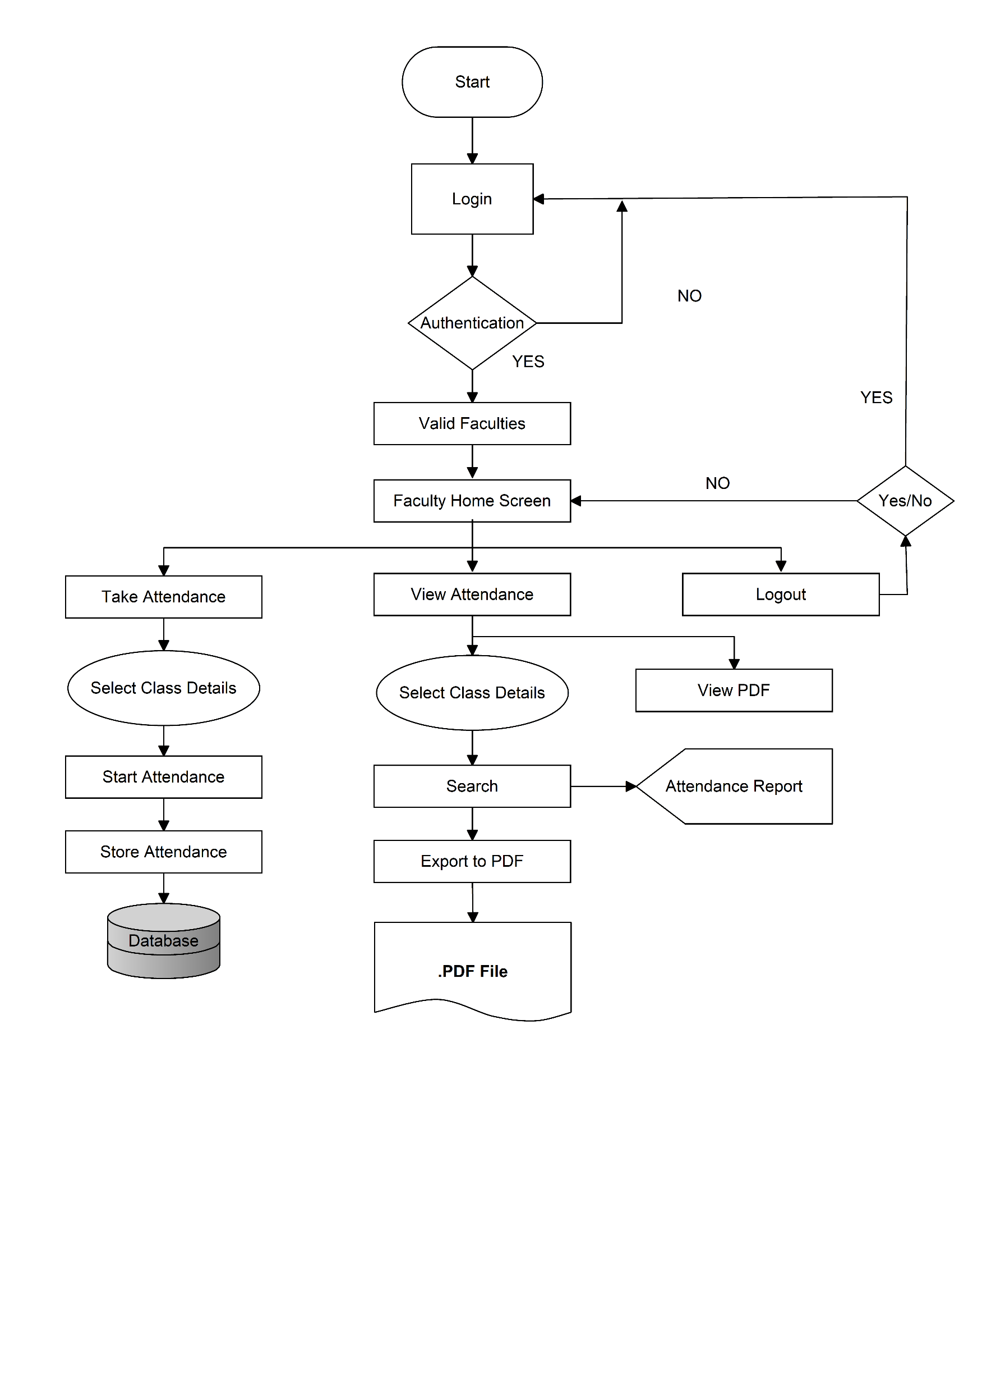
6.3 Faculty Module Design

Slide 27
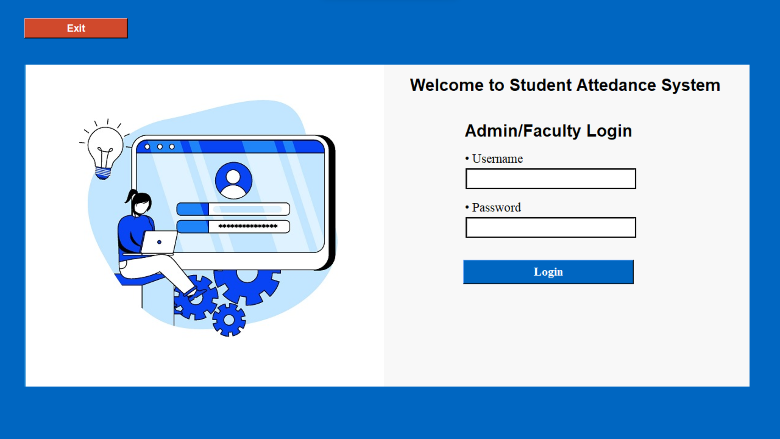
7 Results and Applications
7.1 Results
7.1.1 Login

Slide 28
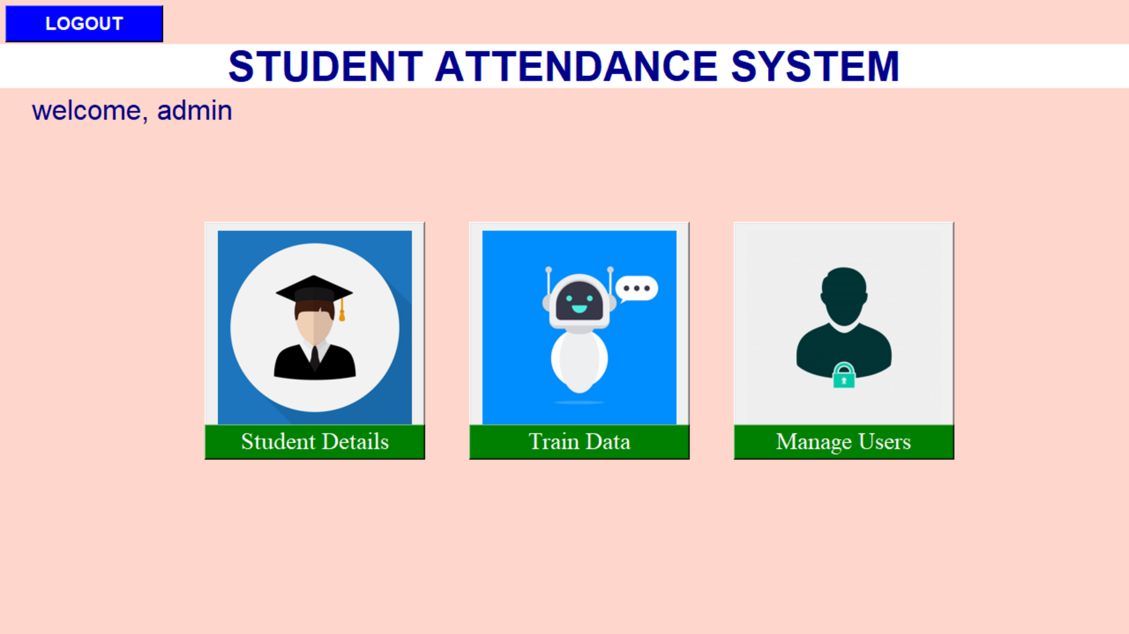
7.1.2 Admin Home Screen

Slide 29
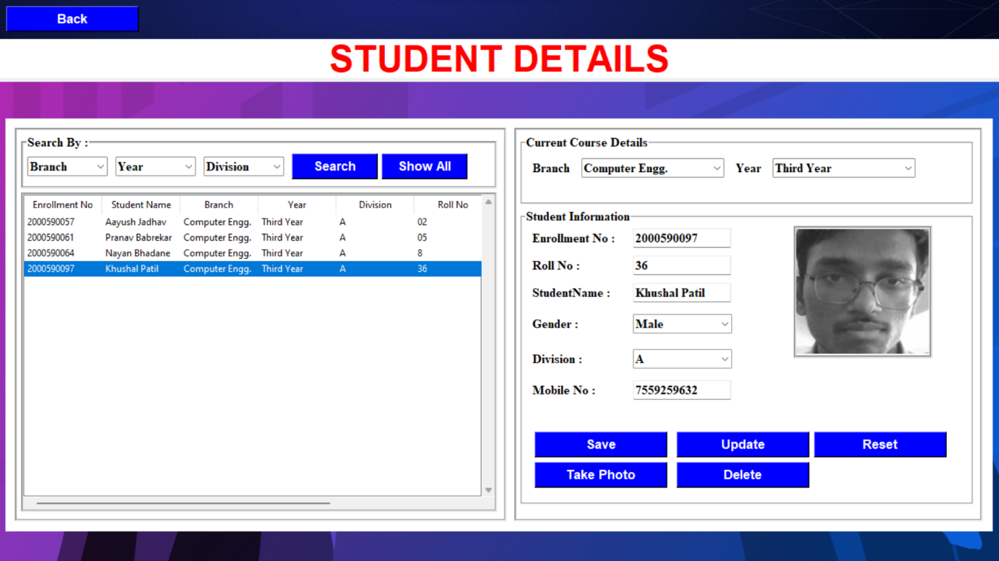
7.1.3 Student Details Screen

Slide 30
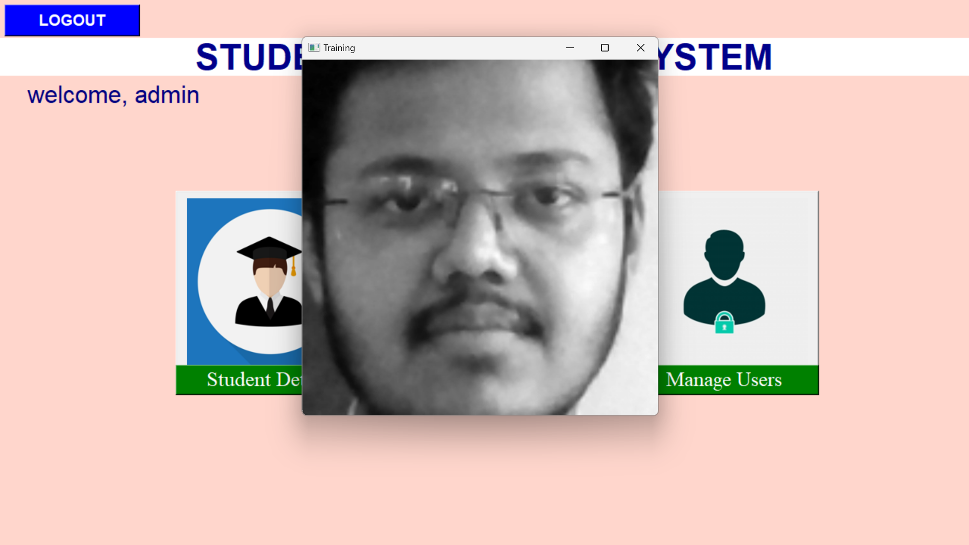
7.1.4 Training Dataset

Slide 31
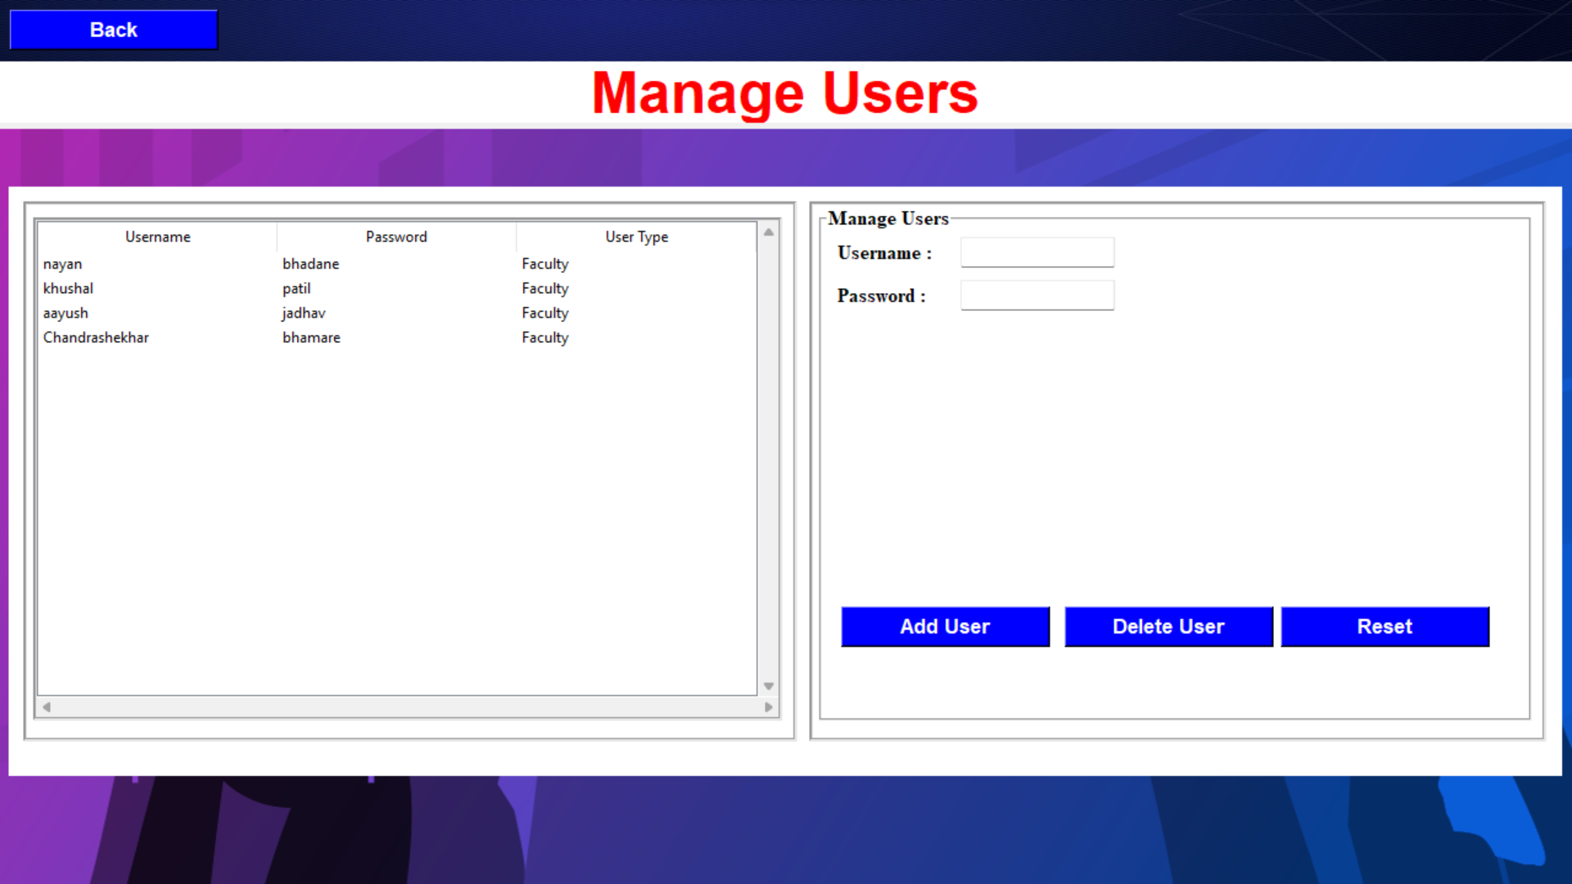
7.1.5 Manage Users Screen

Slide 32
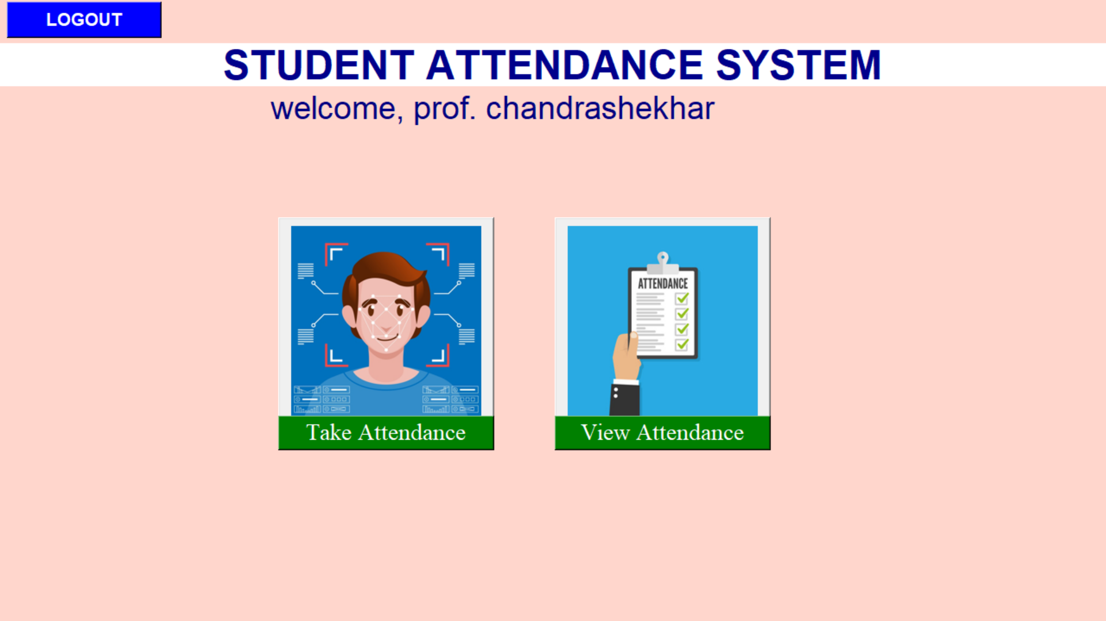
7.1.6 Faculty Home Screen

Slide 33
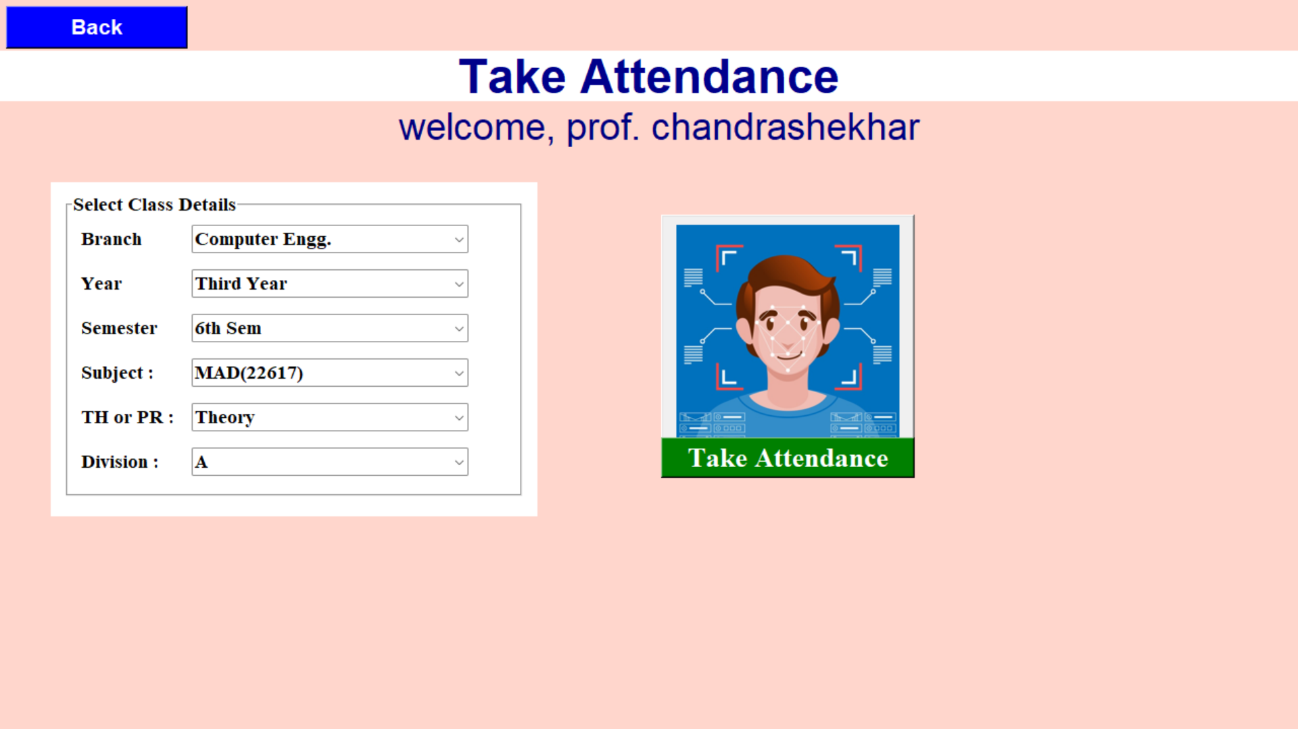
7.1.7 Take Attendance Screen

Slide 34
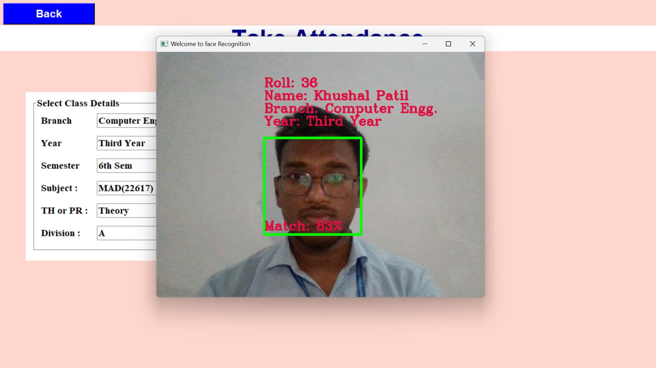
7.1.8 Live Attendance Marking

Slide 35
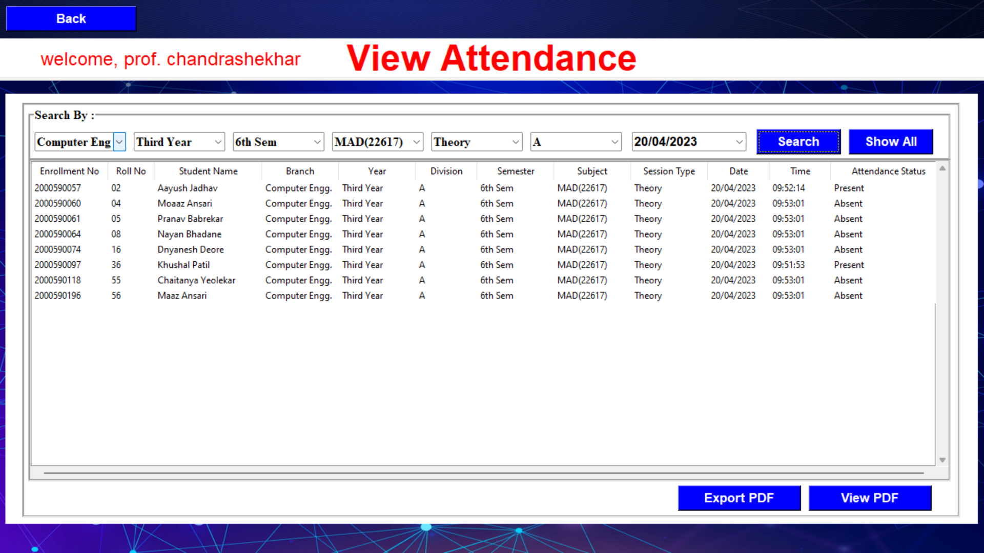
7.1.9 View Attendance Screen

Slide 36
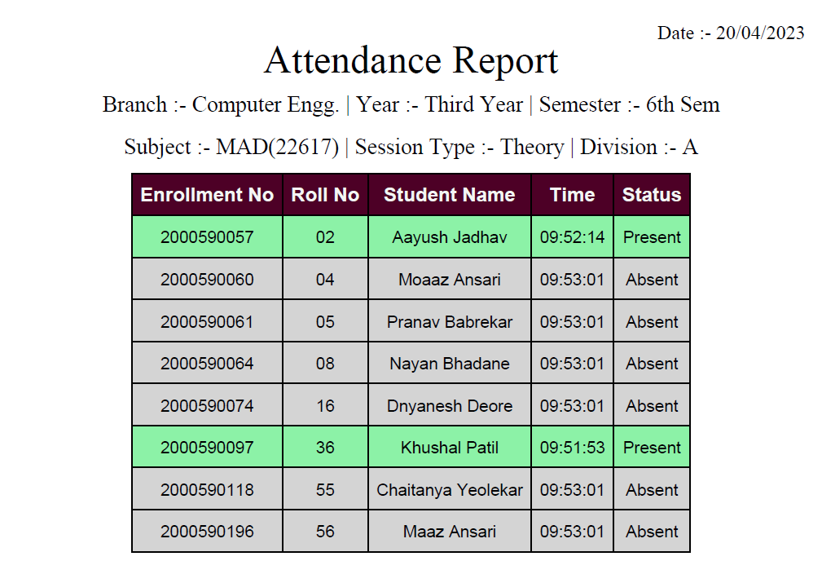
7.1.10 Attendance Report

Slide 37
7.2 Applications
This project can be used for marking theory and practical attendance of Students

Slide 38
8. Conclusion and future scope
8.1 Conclusion
In this study, our system successfully recognizes a student with unintentional changes like wearing glasses or growing beard able to identify the faces of students with an accuracy rate up to 90%.
Face recognition is safer from spreading infectious disease than the contacted method, e.g. fingerprint, signing, etc.
Here the problem is the dataset is small and is affected by the lighting in data collection

Slide 39
8.2 Future Scope
Better dataset can be made and haar cascade classifiers can be improved which will improve the recognition rate
A system alert (voice) can be included if an unknown person is detected in the class
Parent of the student will get SMS alert about his/her absentee.

Slide 40
9. References and Bibliography
[1] Bharat T. Chinimilli, Anjali T, Akhil Kotturi, Vihas R. Kaipu, Jathin Varma Mandapati, “Face Recognition based Attendance System using Haar Cascade and Local Binary Pattern Histogram Algorithm”, 4th International Conference on Trends in Electronics and Informatics (ICOEI) (48184)(2020)
[2] Ononiwu G. Chiagozie, Okorafor G. Nwaji, “Radio-frequency identification (RFID)based Attendance System with Automatic Door Unit”, Academic Research International (2012).
[3] O. Shoewu, PhD, O.A. Idowu, B.Sc., “Development of Attendance Management System using Biometrics.”, The Pacific Journal of Science and Technology (2012).
[4] Jomon Joseph1, K. P. Zacharia, “Automatic Attendance Management System Using Face Recognition”, International Journal of Science and Research (IJSR), 2013.

Slide 41


